Slide 1
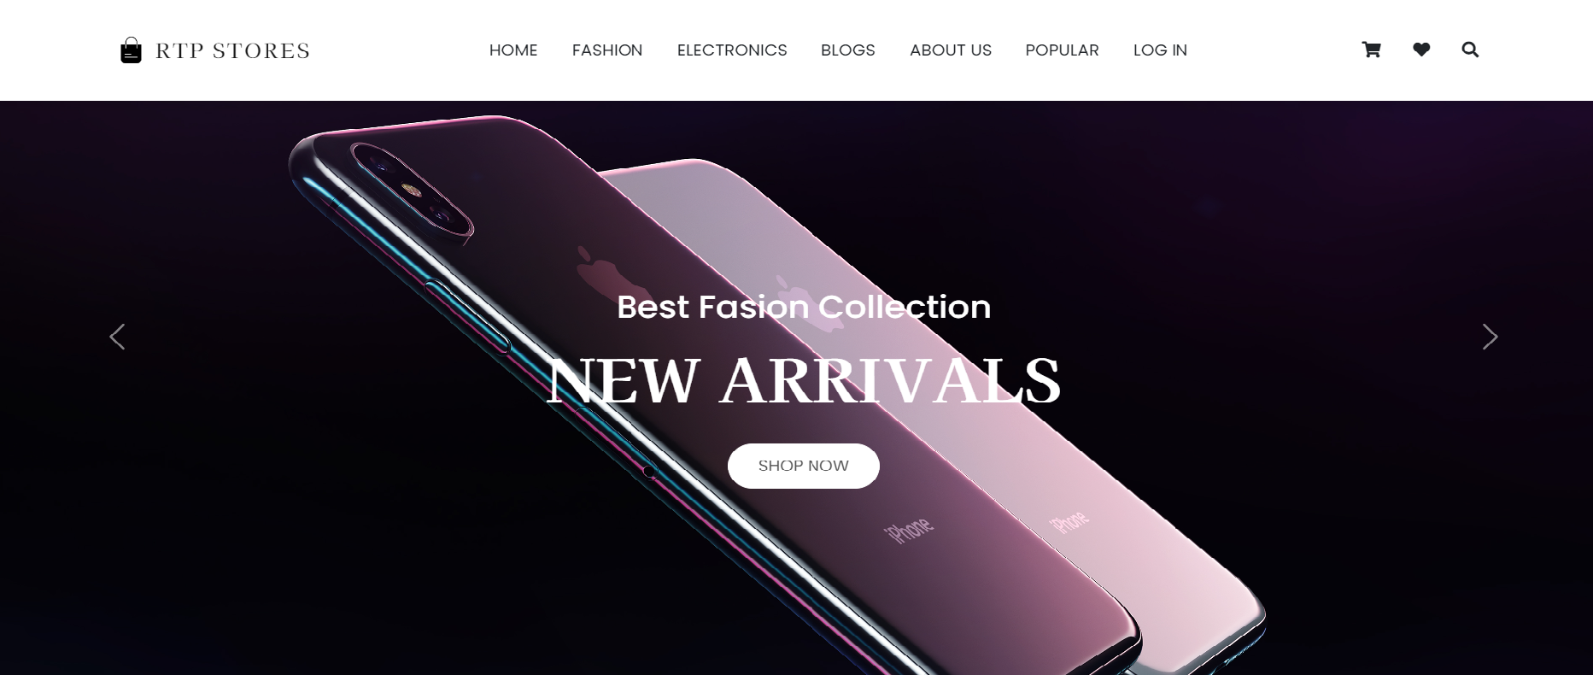

CLASS PROJECT
CUSTOMER RETENTION ANALYSIS
Presented By:
DA/DS BATCH 4

Slide 2
ABSTRACT
Customer retention is a crucial aspect of business success, with direct impacts on a company's profitability and long-term sustainability. This group project is aimed to investigate customer retention strategies and practices in the context of E-commerce website (RTP STORES) . The project explored various approaches and techniques used by companies to retain their customers, including loyalty programs, personalized marketing, and exceptional customer service.
The project utilized a combination of qualitative and quantitative research methods, including literature review and data analysis, to examine the effectiveness of different customer retention strategies. The findings revealed key factors influencing customer retention, such as customer satisfaction, trust, and loyalty. The project also identified challenges and opportunities in implementing customer retention strategies, including resource allocation, data management, and customer segmentation.
To summarize, this group project contributes to the understanding of customer retention in the context of E-commerce website (RTP STORES) and provides practical recommendations for businesses to enhance their customer retention efforts and achieve sustainable business growth.

Slide 3
INTRODUCTION TO RTP STORES
RTP Stores is a leading e-commerce company that specializes in providing high-quality products to customers worldwide. Our mission is to offer a seamless shopping experience through our user-friendly website and mobile app, with a wide range of products to meet the diverse needs of our customers.
At RTP Stores, we pride ourselves on our commitment to customer satisfaction. We understand that today's consumers have high expectations when it comes to online shopping, which is why we go above and beyond to provide a personalized and efficient service. Our team is dedicated to ensuring that every customer enjoys a hassle-free shopping experience, from browsing our products to placing an order and receiving their delivery.
With a vast selection of products, from electronics and gadgets to fashion and beauty items, RTP Stores is your one-stop shop for all your online shopping needs. Our product range is constantly evolving to keep up with the latest trends and consumer demands, ensuring that our customers always have access to the newest and most innovative products on the market.
In addition to our commitment to customer satisfaction, RTP Stores is also committed to sustainability and social responsibility. We strive to minimize our environmental impact by adopting sustainable practices throughout our operations, and we also support charitable initiatives that help to make a positive difference in the world.
We are proud to be a part of the e-commerce industry, and we are dedicated to delivering the best possible online shopping experience to our customers. Thank you for choosing RTP Stores for your online shopping needs.
WEBSITE: file:///C:/Users/Hp/Downloads/RTP%20Stores%20(1)/RTP%20Stores/index.html

Slide 4

PROBLEM STATEMENT
RTP stores has noticed a decreasing trend in customer loyalty over the past year, which is affecting the company's revenue and market share.
The objective of this project is to analyze customer behavior and preferences, identify factors that contribute to customer disloyalty, and develop targeted retention strategies to improve customer satisfaction and loyalty.

Slide 5
OBJECTIVES
To identify the factors contributing to the churn rate of the customers of electronics section of the company.
To identify key factors influencing customer retention, such as customer satisfaction.
To explore various approaches and techniques used by companies to retain their customers, including cashback loyalty programs, personalized marketing, and exceptional customer service.
To provide practical recommendations for businesses seeking to enhance their customer retention efforts and achieve sustainable business growth

Slide 6

INTRODUCTION TO CUSTOMER RETENTION
Customer retention is a critical aspect of business success, and in today's competitive landscape, companies are constantly seeking ways to retain their existing customers and build long-term relationships with them. This group project on customer retention aims to investigate effective strategies and practices in the context of E-commerce website (RTP STORES). The project involved a multidisciplinary team of experts, including those responsible for data collection, data processing, visualization, and front-end development.
Acquiring a new customer can cost five times more than retaining an existing customer. Increasing customer retention by 5% can increase profits from 25-95%. The success rate of selling to a customer you already have is 60-70%, while the success rate of selling to a new customer is 5-20%. They also have a higher average order value than first-time consumers. By contributing to the understanding of customer retention, this project aims to assist businesses in developing effective strategies to retain customers and build lasting relationships with them.

Slide 7
WHAT IS CUSTOMER RETENTION AND CUSTOMER CHURN ?
Customer retention refers to the ability of a business to retain its existing customers over a period of time. It involves building long-term relationships with customers by providing high-quality products or services, excellent customer service, and personalized experiences that meet their needs and expectations. Customer retention is important for businesses because it can lead to increased customer loyalty, repeat purchases, positive word-of-mouth referrals, and ultimately, sustained revenue growth.
On the other hand, Customer churn refers to the rate at which customers discontinue using a product or service. It reflects the number of customers who cancel their subscriptions, switch to a competitor, or simply stop using a product or service over a given time period. High churn rates can be a cause for concern for businesses because they indicate a lack of customer loyalty or satisfaction, and can lead to a decline in revenue and market share. Therefore, reducing churn and retaining more customers is a key objective for businesses that want to achieve sustainable growth.

Slide 8
EXPLORATORY DATA ANALYSIS (EDA)
Exploratory Data Analysis (EDA) is a critical first step in any data analysis project. EDA involves examining and visualizing the data to identify patterns, trends, and relationships between variables. The team conducted EDA on the customer retention data set using Python programming language.
The EDA included the following steps:
Data cleaning: The team removed any missing or duplicate data points and corrected any inconsistencies in the data.
Descriptive statistics: The team calculated summary statistics, such as mean, median, and standard deviation, for key variables to gain a better understanding of the data distribution.
Data visualization: The team created a range of visualizations to get the insights from the data set.
(PYTHON PRESENTATION)

Slide 9
CHURN RATE ANALYSIS
Churn rate is a crucial metric for businesses that reflects the number of customers who discontinue using a product or service. To calculate the churn rate, the team analyzed the historical customer data, including the number of customers who left the business during a specific time period.
The churn rate was calculated as follows:
Churn Rate = (Number of Customers Lost During a Specific Time Period / Total Number of Customers at the Start of the Time Period) x 100%
The team analyzed the churn rate over time to identify any trends or patterns that could inform customer retention strategies. The analysis revealed that the company's churn rate was around 35% over the year 2021. This indicates that we are at better position from last year, but still our churn rates are higher than critical value which could be a cause for concern.
(TABLEAU PRESENTATION)

Slide 10
APPLIED CUSTOMER RETENTION STRATEGIES
Personalization: Personalizing the customer experience by tailoring product recommendations, offers, and marketing messages to individual customers based on their preferences and behavior.
Excellent customer service: Providing prompt and helpful customer support, resolving issues quickly and effectively, and showing appreciation for customer loyalty.
Rewards and loyalty programs: Offering discounts, special offers, and other incentives to reward loyal customers and encourage repeat purchases.
Increasing customer engagement: Building a sense of community among customers by creating social media groups, forums, or events where customers can connect and share their experiences. This also results in increasing customer engagement on website.
Continuous improvement: Continuously improving the quality of products, services, and customer experiences based on customer feedback and market trends.
Quick delivery : Advance supply chain, reduces delivery distance thus delivery time and cost.
(TABLEAU PRESENTATION)

Slide 11
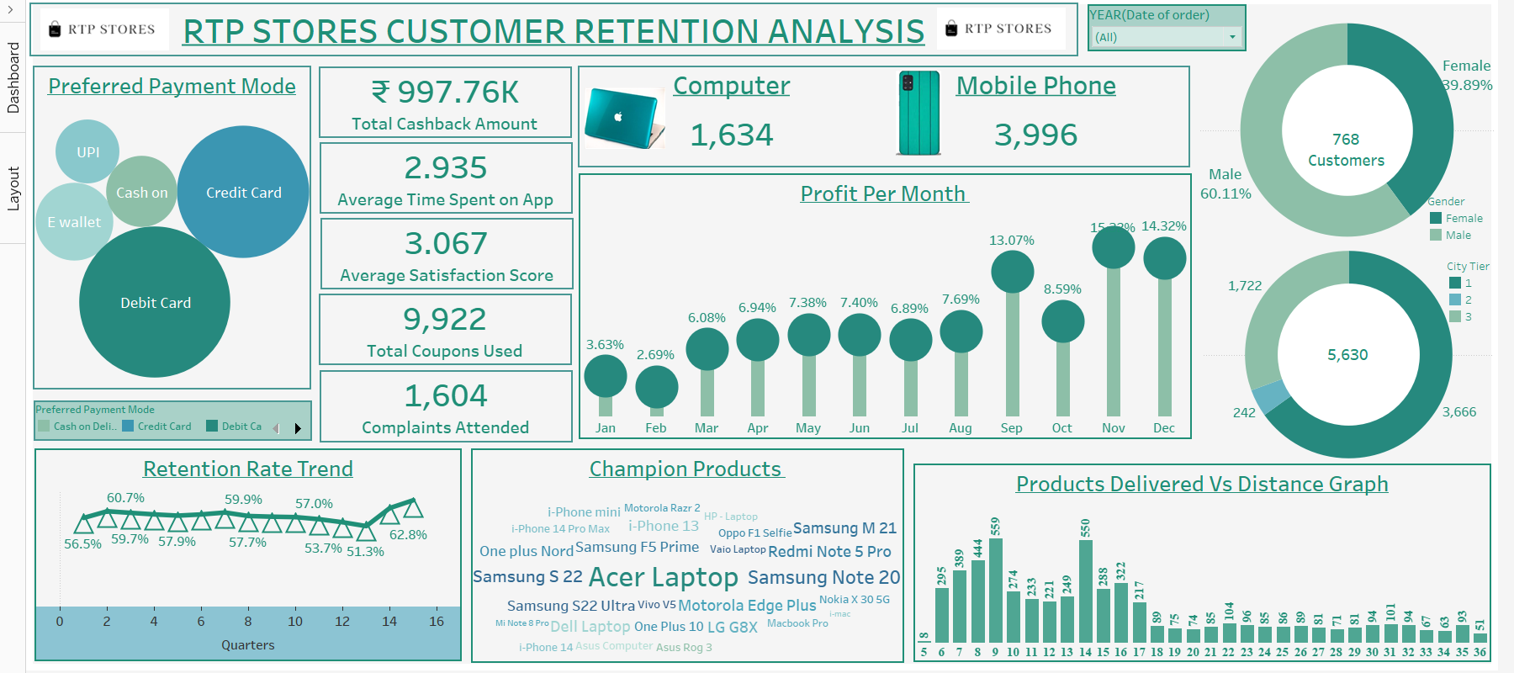
DASHBOARD

Slide 12
CONCLUSION
Customer retention is a crucial aspect of any business that can make the difference between success and failure. By focusing on retaining customers, businesses can reduce customer churn, improve brand loyalty, and drive long-term revenue growth. Throughout this project, we have conducted extensive research and analysis to understand the factors that contribute to customer retention and churn rates. Through this, we have identified various strategies that can be used to improve customer retention, such as personalized communication, excellent customer service, loyalty programs, and community building.
By leveraging the insights and strategies developed in this project, businesses can take a proactive approach to customer retention and implement tailored strategies to meet their specific needs. Through the use of data analysis, businesses can better understand their customers and personalize their experiences, leading to increased satisfaction and loyalty. By adopting customer-centric strategies, businesses can build strong relationships with their customers, which can drive repeat business and positive word-of-mouth referrals.
As the competitive landscape continues to evolve, businesses that prioritize customer retention will be better positioned to succeed. By investing in customer retention strategies, businesses can differentiate themselves from their competitors and build a loyal customer base that supports long-term growth and success.

Slide 13

VOTE OF THANKS
We would like to take this opportunity to extend our heartfelt thanks to everyone who has contributed to the successful completion of our group project on customer retention.
First and foremost, we would like to express our deepest gratitude to our project supervisors Ms. Nidhi Sharma and Mr. Mario Thokchom , whose unwavering support and guidance have been invaluable throughout the project. We are grateful for their expertise, constructive criticism, and encouragement that have helped us to stay focused and motivated.
We would also like to thank our whole batch who provided us with valuable insights and ideas during our discussions. Their suggestions and feedback were instrumental in shaping our research and analysis.
Finally, we would like to express our heartfelt appreciation to our families and friends who stood by us throughout the project, offering us encouragement and support during challenging times. Thank you all for your contributions to our project, which would not have been possible without your support and assistance.

Slide 14



